Slide 1
ML
Hackathon
PRODUCT ANALYSIS
By
P.Roopa

Slide 2

Prediction of Products using Machine learning

Slide 3
Technology stack
Language used-R
R Studio
Shiny for web interface using R

Slide 4
New variant of a product whick can yield profit to company
selling cost of this new variant of a product
Fixed service charges
Estimated service cost

Slide 5
Algorithm
K-Nearest Neighbour
supervised learning algorithm, where the destination is known, but the path to the destination is not. Understanding nearest neighbors forms the quintessence of machine learning.

Slide 6
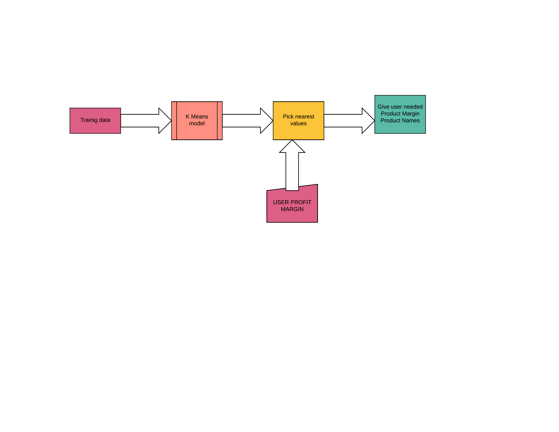
High level solution Architecture

Slide 7
STEPS IN IMPLEMENTED
From User Profit Margin is got through Shiny Web APP.
In background Values are calculated using k-Means.
User Entered Profit margin
Matches
Gives product id,selling cost,service cost
Sorry,
Input did not match to any nearer margin
Did not match

Slide 8
Challenges faced
Choosing the best Algorithm
Minimizing error value

Slide 9
Possible Improvement
01
CUSTOMER PREFERENCE CAN BE INCLUDED FOR ACHIEVING MORE PROFIT
r
02
VISUALIZED OUTPUT

Slide 10
